Slide 1
What is Money?
The 3 Main Functions of Money
Copyright Stock-Trak, Inc. 2023-2024

Slide 2
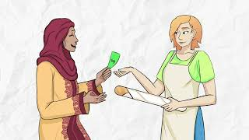
Notes:
What is Money Animated Video: https://youtu.be/27uCpZblVKY

Slide 3
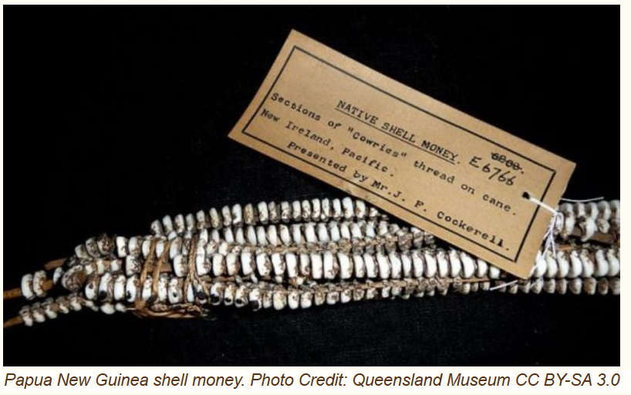
Introduction to Money
Bartering: Previously, people traded items directly for desired goods or needs.
Money is a widely-accepted medium of exchange for goods and services. We as society agree upon its assigned value, making it crucial for transactions.
In the past, we used commodities like seashells, salt, and spices, as a medium of exchange!
Cowry Shell Coins
Notes:
Reference: Cowry shell coins: an ancient monetary system based on sea shells used on almost every continent | The Vintage News
Observing the evolution of money helps in comprehending the complexities of the modern financial system:
•Historically, seashells, salt, spices, precious metals, and even diamonds were used as mediums of exchange.
•The use of government-backed printed currency became standard by mid-1800s.
•Printed money was lighter, easier to carry, and represented a standard value, making it more practical than carrying valuable metals or commodities.
•Today, transactions also use digital forms of money, like online bank transactions, digital wallets, and contactless payments.
•The emergence of cryptocurrencies like Bitcoin represents a significant shift, utilizing decentralized, blockchain technology.
•However, they have not yet fully fulfilled all criteria to be considered 'money.'

Slide 4
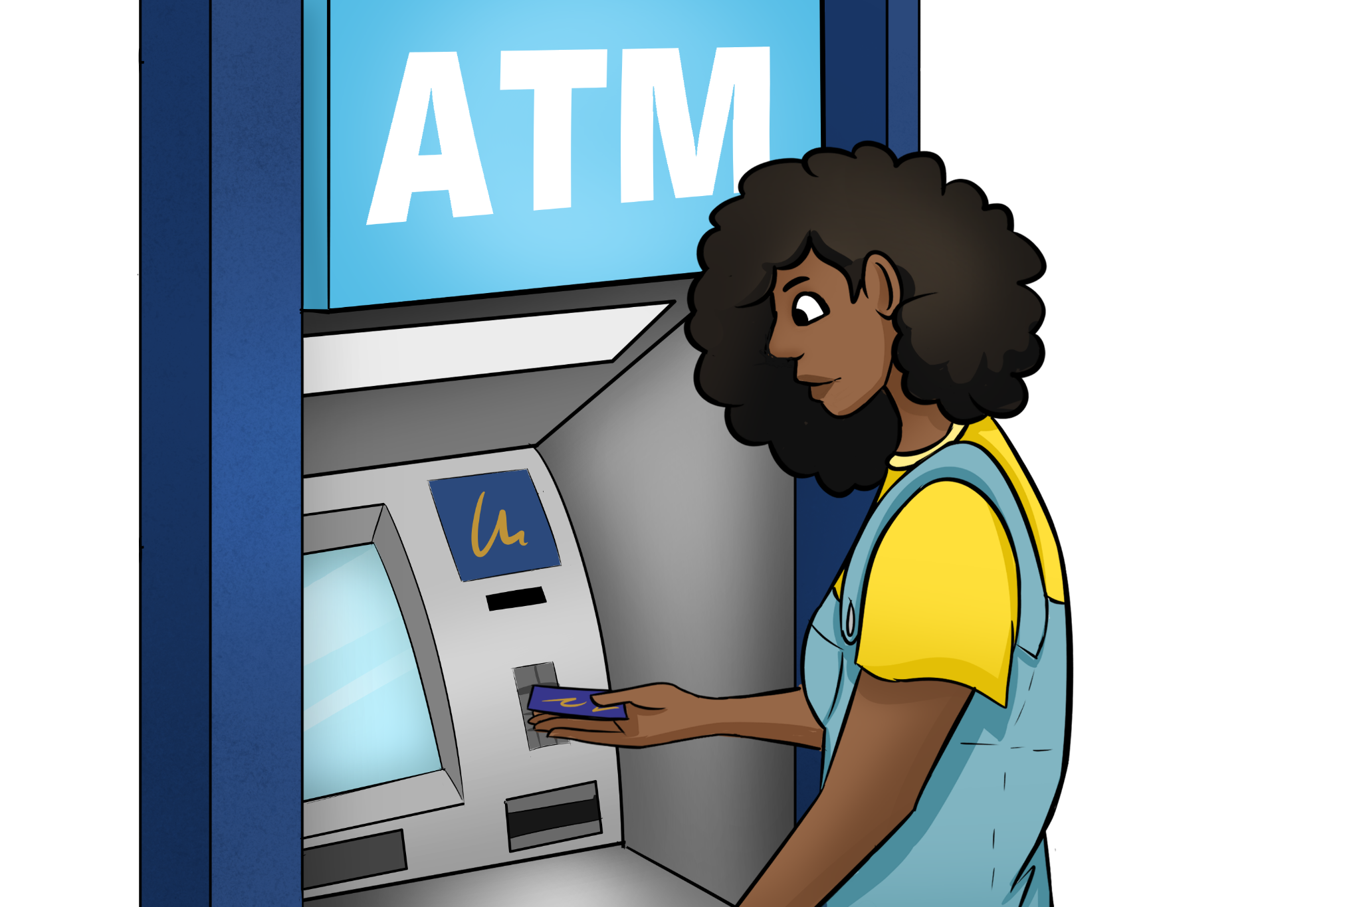
Functions of Money
Test #1. Medium of Exchange
Money acts as a go-between for individuals and companies in the economy to help trade.
For Example:
Debit cards can act like money since it’s tied directly to your checking account.
Notes:
In the 3-item test, the first function must be that the form of money is a medium of exchange. It must be widely accepted as a form of payment for goods and services.
Checks and debit cards act as a convenient alternative to carrying physical cash and serve as a medium of exchange for transactions. However, they are not considered money themselves, as they rely on funds in a bank account to facilitate the transfer of value.
Debit cards, with a microchip for additional security, are controlled electronically and transactions are processed instantly. When you want to buy something, the seller will know immediately whether the funds were transferred to them, or if the transaction was rejected due to a lack of funds.
When using a check, you write a specific amount, which serves as a promise to pay that amount to the recipient. The recipient can then deposit or cash the check, transferring the funds from your account to their own.

Slide 5
Functions of Money
Test #2. Unit of Account
Money allows us to measure the value of goods and services.
For Example:
A basket of eggs ≠ A carpenter’s labor or service
Notes:
In the 3-item test, the second function must be that the form of money is a unit of account.
The unit of account function of money refers to its ability to provide a standardized measurement for valuing different goods and services. It allows us to compare and calculate the worth of different objects or labor in a consistent and easily understandable way. Since goods and services are valued in part by how difficult it is to reproduce or find an alternative, money provides us a universal understanding of what a specific item or service is worth.
For example, let's say the market price for a basket of eggs is $5, and the hourly rate for a carpenter's labor is $50. In this scenario, we can use money as a common unit of account to express the value of these two items in monetary terms. By assigning a dollar value, we can easily compare and understand that the labor of a carpenter is considered more valuable than a basket of eggs.
Without money acting as a unit of account, it would be challenging to compare and quantify the value of these different items accurately. The disparities in their value stem from various factors, such as scarcity, demand, and the skills and expertise involved

Slide 6
Functions of Money
Test #3. Store of Value
Money doesn’t expire and is able
to retain its intrinsic value over time.
For Example:
Gold coins or bars
Notes:
In the 3-item test, the third function must be that the form of money is a store of value. A store of value refers to an asset or commodity that can be saved, accumulated, and used to retain purchasing power over time.
Gold has been recognized as a store of value for centuries due to its inherent properties. Unlike paper currencies or other commodities, gold is scarce and has a relatively stable supply. Its limited supply and the difficulty in extracting it from the ground give it intrinsic value. Gold is also durable and does not corrode like other metals. It can be stored for extended periods without significant degradation, making it an ideal medium for preserving value over time.
Because of its ability to hold its intrinsic value, gold can be used as a form of money or a store of wealth. Individuals often invest in gold as a hedge against inflation or economic uncertainties, as its value tends to hold up or increase during periods of economic instability.

Slide 7
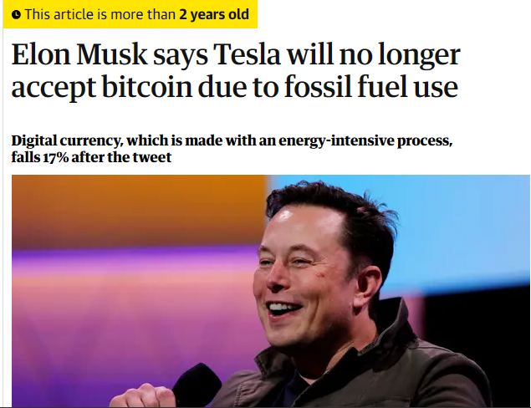
Why Bitcoin & Altcoins Are Not Money
Test #1: BTC isn’t a medium of exchange because it is not widely accepted. When BTC is used, it is converted to USD to calculate the price.
For Example:
Tesla accepted BTC as payment, but later stopped.
Notes:
Reference: Elon Musk says Tesla will no longer accept bitcoin due to fossil fuel use | Tesla | The Guardian
Bitcoin and other crypto currencies fail all three tests.
For it to be money, a very large number of people and businesses need to accept it as a form of payment. Even when BTC was accepted (Tesla famously accepted BTC as payment, but later stopped), it was converting BTC to dollars to calculate the price.
Here is a list of companies that currently accept Bitcoin as payment: Who Accepts Bitcoin in 2024? List of 20+ Major Companies (99bitcoins.com)
Use this search engine to look up companies that accept Bitcoin: Spend Bitcoin at Hundreds of BTC-Enabled Stores – Spendabit

Slide 8
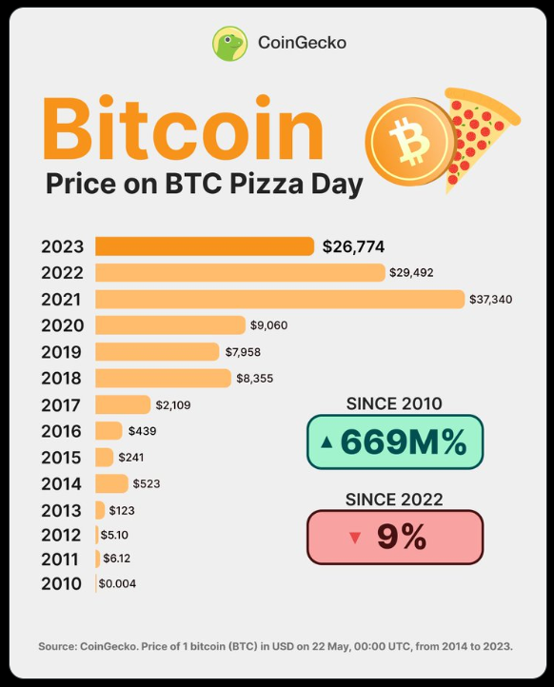
Why Bitcoin & Altcoins Are Not Money
Test #2: BTC isn’t a unit of account because the price changes so rapidly.
For Example:
How many pizzas can you buy with a bitcoin?
Notes:
Reference the Bitcoin Pizza Index
Bitcoin fails the second test, it cannot be a unit of account, because the price changes too fast.
The first ever Bitcoin transaction was for 2 extra large pizzas on May 22nd 2010. This is now BTC Pizza Day.
Laszlo Hanyecz spent 10,000 BTC for his dinner, ‘The famed Bitcoin Pizzas from Papa John’s are now worth $267 million.’ reference DailyCoin.

Slide 9
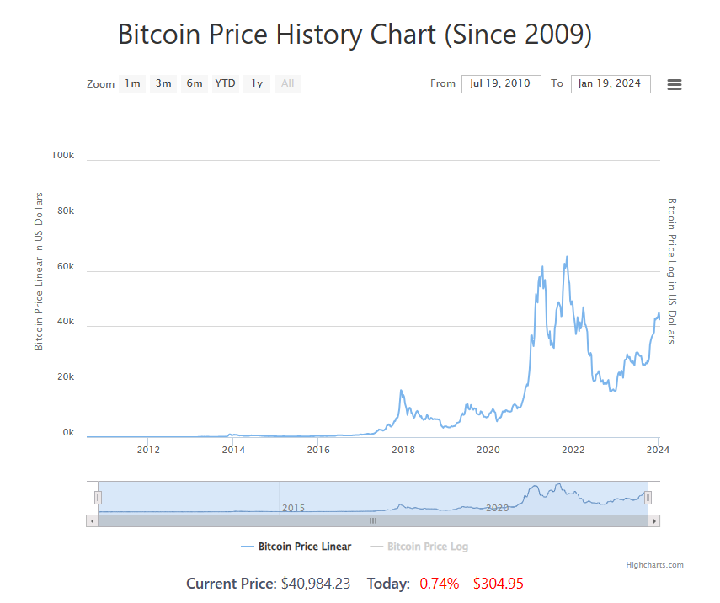
Why Bitcoin & Altcoins Are Not Money
Test #3: BTC isn’t a store of value because the price is too volatile.
What will Bitcoin be worth in one year? (No one knows)
We do know what USD will buy, (with some uncertainty for inflation).
Notes:
BTC Price Volatility, all data was provided by: Bitcoin Price History Chart (2009, 2010 to 2024) (buybitcoinworldwide.com)
Bitcoin's price has ranged from $0 to its highest at $68,991.
On February 9th, 2011, BTC reached a value of USD$1.00 for the first time ever.
2017 is a year that lives in crypto history. The year saw a steady appreciation in the price of Bitcoin followed by a huge blow-off top to nearly $20,000. This was the first time that Bitcoin broke into the mainstream of public opinion.
Triggered by the Covid-19 pandemic, a global liquidity event, Bitcoin sold off nearly 40% on March 12. It hit a low of $3,850 before doubling in price over the next six weeks.

Slide 10
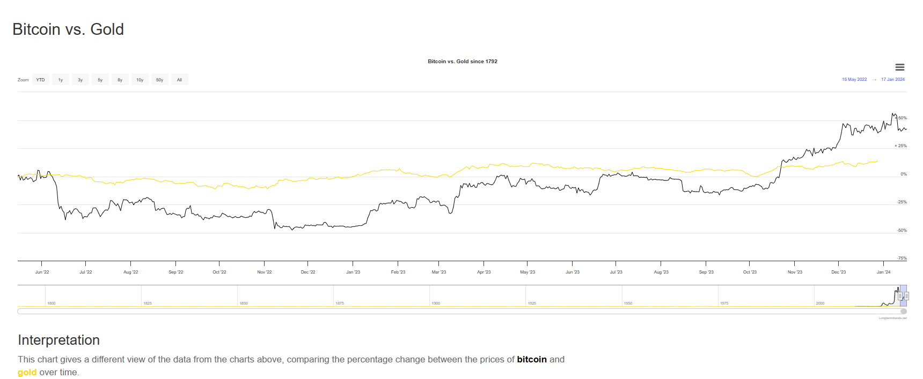
BTC vs Gold
Notes:
Reference: Bitcoin vs. Gold - Updated Chart | Longtermtrends
As this chart shows, the price of gold is far more stable than the price of Bitcoin that still is rising and crashing unpredictably.
Gold coins are still made today, even though they aren’t used as money anymore. Governments make a profit from selling gold coins to collectors and gold investors. Not for the face value of the coin.
Both Gold and Bitcoin have a finite supply and are not manipulated by central banks or governments like other fiat currencies.

Slide 11
Discussion Questions
As technology continues to evolve in our society, is it possible that the way we store our money and pay for transactions will change?
What do you think that process might look like 15 years from now?
Notes:
Increased prevalence of digital payments: With the advancement of technology, it is likely that digital payment methods will become even more commonplace. We can expect to see a significant shift away from traditional cash and physical payment cards towards digital wallets, mobile payment apps, and other secure online payment platforms.
Biometric authentication: As technology evolves, we may see the implementation of biometric authentication methods for payment purposes. This could include using fingerprints, retina scans, or facial recognition to verify a person's identity and authorize transactions, further enhancing security and convenience.
Internet of Things (IoT) payments: The increasing connectivity of everyday objects through IoT technology opens up the possibility of seamless and automated payments. For example, smart refrigerators could automatically restock groceries and make payments on behalf of the user, eliminating the need for manual purchases.
Blockchain technology: Blockchain, the underlying technology behind cryptocurrencies, has the potential to revolutionize payment systems. It provides a secure and transparent decentralized ledger, which could be adopted by financial institutions and businesses for faster and more secure transactions.
Peer-to-peer payments: Peer-to-peer payment platforms, such as Venmo and PayPal, have gained popularity over the years. As technology continues to evolve, these platforms may become more seamless, allowing for instant and secure money transfers between individuals.

Slide 12
Discussion Questions
What additional security measures do you see happening in the future to keep scammers from fraudulently stealing people’s money?
Notes:
Biometric authentication: methods such as fingerprint scanning, retina scans, and facial recognition can significantly enhance security. These unique physical characteristics provide a more reliable and difficult-to-replicate form of identity verification, making it harder for scammers to gain unauthorized access to accounts.
Behavioral analysis: Advanced AI systems can analyze user behavior patterns and detect any anomalies or suspicious activity. This can help identify unusual transactions or account access attempts and trigger alerts or additional verification steps to prevent fraud.
Two-factor authentication: Two-factor authentication (2FA) adds an extra layer of security by requiring users to verify their identity through another device or method. This can involve receiving a one-time password via SMS, using an authentication app, or using hardware tokens. Implementing 2FA can significantly reduce the chances of unauthorized account access.
Tokenization: Tokenization replaces sensitive payment information, such as credit card numbers, with unique tokens. These tokens are meaningless and cannot be decrypted to retrieve the original data.

Slide 13
Discussion Questions
Describe other potential forms of money and discuss why they might fail the 3-item test.
Notes:
Other potential forms of money might include commodities like gold, digital currencies like Bitcoin, and alternative currencies like local community currencies.

Slide 14
Key Takeaways
Credit Cards are not actual money but a tool for borrowing.
Money serves as a medium of exchange, allowing for the smooth trade of goods and services.
It acts as a unit of account, providing a standard measurement of value for different goods and services.
Money serves as a store of value, allowing individuals to save their wealth and use it for future expenses.
It facilitates economic activity by enabling transactions and supporting market operations.
Notes:
Credit Cards are not actual money but a tool for borrowing.
Money serves as a medium of exchange, allowing for the smooth trade of goods and services.
It acts as a unit of account, providing a standard measurement of value for different goods and services.
Money serves as a store of value, allowing individuals to save their wealth and use it for future expenses.
It facilitates economic activity by enabling transactions and supporting market operations.

